Slide 1
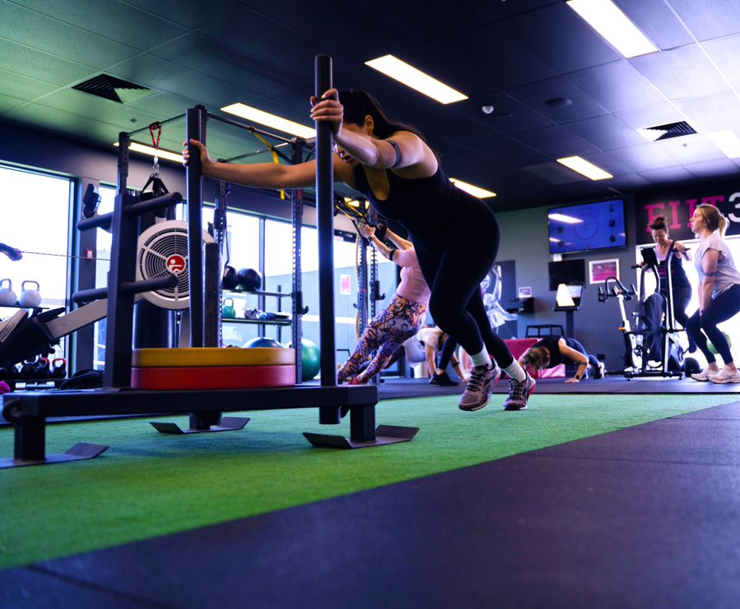

WELCOME
FIIT30
National Training Webinar
Lisa – Marie Gleeson
Notes:
Welcome everyone to today’s FIIT30 training. I’m Lisa. Can everyone hear me ok?
Let’s get started shall we?
FIIT30 as you know, is a fantastic Small Group Functional Training Program that we have developed over the last few years at Fernwood, and since we launched FIIT30 our clubs have come a really long way in building a great program and great sessions to deliver to their members.
As fast as our industry is changing and evolving, we need to ensure our offerings at Fernwood are keeping up. So whilst FIIT30 is a strong program in many of our clubs, we need to continue to keep it fresh in order to keep up with industry standards and also provide reasons and opportunities to entice new members to join.
So today’s training is really all about how we can spice up our FIIT30 programs in club, what we have been working on at NSO to help with this, and what you can implement to ensure you are providing the best service in your club and maximizing your profitability when it comes to FIIT30.

Slide 2
TODAY’S AGENDA
- Fernwood’s new FIIT30 Format
- Timetabling
- FIITMAX & FIITRIGHT
- Setting FIIT30 Targets
- Pricing
- Sales Strategies
- Trainer Upskilling
- Let’s hear from…Browns Plains
- Let’s hear from…Narre Warren
- Let’s hear from…Woonona
Notes:
I will begin the session by providing an overview of today’s key topics which you can see on the slide here, but what I’d really like to do for most part of today is actually talk to the people and the clubs that are doing all of these things successfully.
So I have some of our FIIT30 superstars ready to talk about what they have achieved with their programs and also answer any questions that you might have of them.

Slide 3
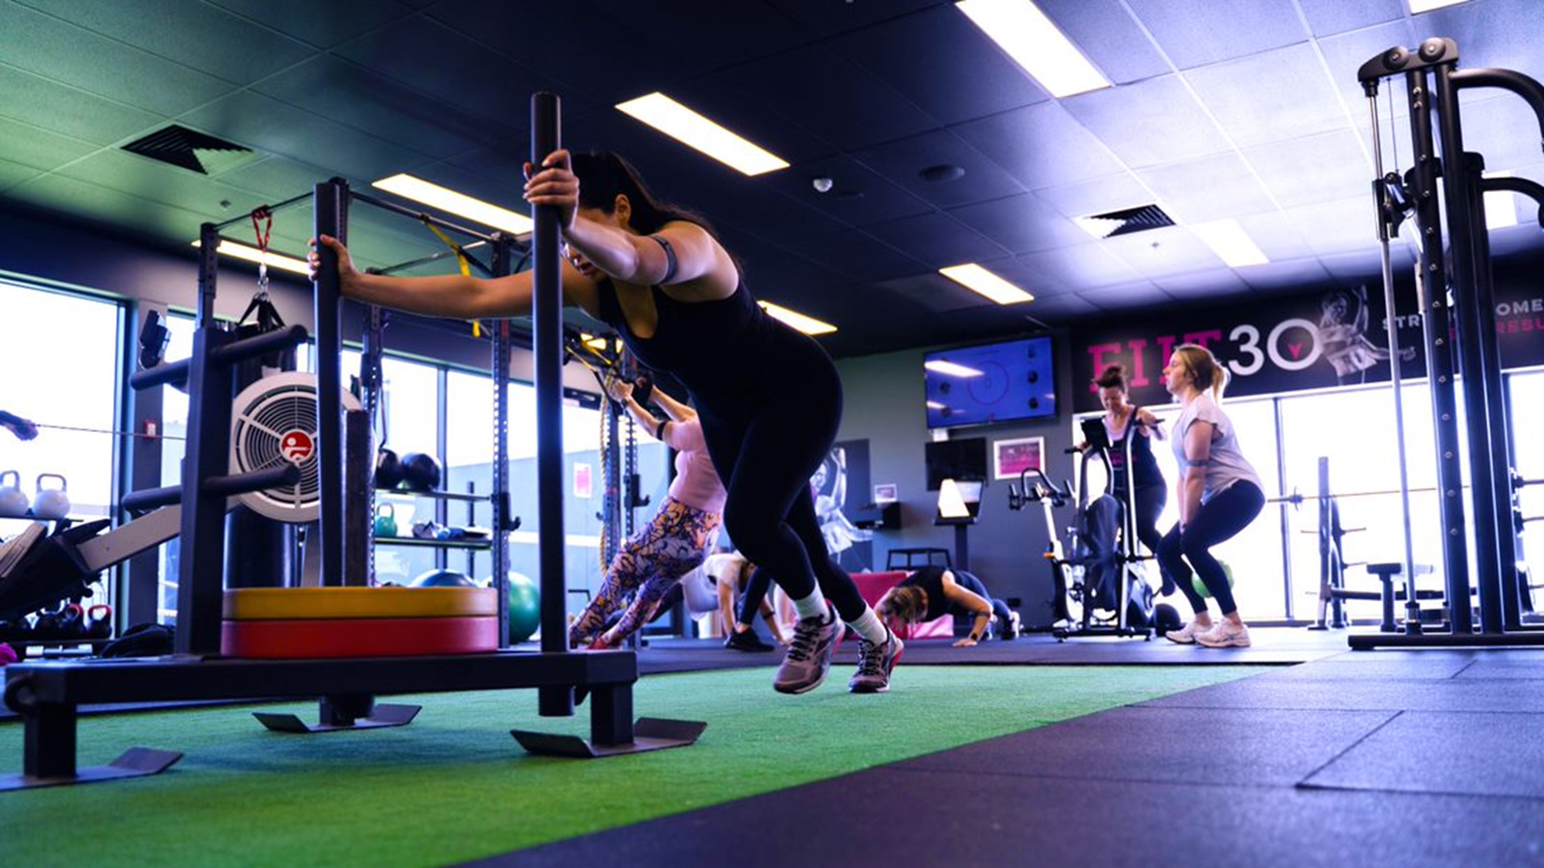

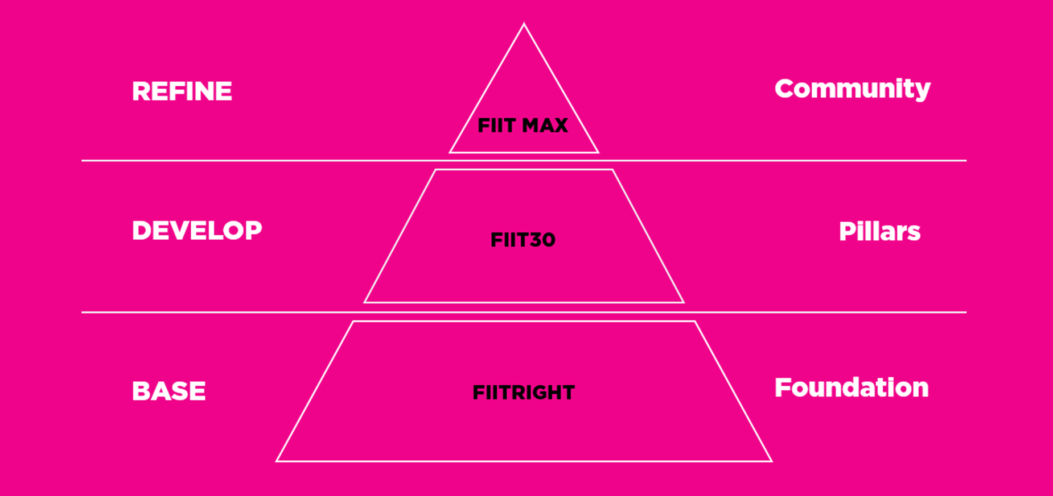
Fernwood’s New FIIT30 Format
Notes:
So to begin today by talking about Fernwood’s new FIIT30 format. Some of you may be familiar with this pyramid on the screen, and for some of you this may be brand new.
This pyramid is basically a visual representation of our FIIT30 program.
And at the bottom there, the biggest, most important part of our program is the base.
This is where we are responsible for laying a solid foundation for our members by teaching them the basics of functional training and functional movement so they can continue on for years to come, safely, confidently and purposefully in FIIT30 and get the results they need.
Now FIITRIGHT doesn’t mean FIIT30 but keep it extremely basic. It doesn’t mean bodyweight training only, or the simplest of exercises. We want to be teaching the same movement patterns that will be seen in FIIT30 and FIITMAX, but just at a slower pace. And I will talk more on that in a moment.
Next up we in the middle of our pyramid, we have our original FIIT30 offering.
In FIIT30 we aim to work on building strong pillars above our foundations by developing the skills that were taught in FIITRIGHT.
We start looking at working at a faster pace or using heavier weights.
Lastly at the very top we find FIITMAX. Now FIITMAX makes up the tip of this ice-berg but in reality today it’s probably going to be one of the biggest focusses. FIITMAX is used to refine all the skills we have built in FIITRIGHT and FIIT30, and to use those skills to start honing in on strength training and performance. Now I have put community up the top there.
Of course we want to build a community in all of our FIIT30 formats – that really is the essence of the program, but community for FIITMAX is all about building a space where members are really working together to track and build their strength and work on progression as a team. It is also a space where you can look at competition like challenges and fiit30 games.

Slide 4
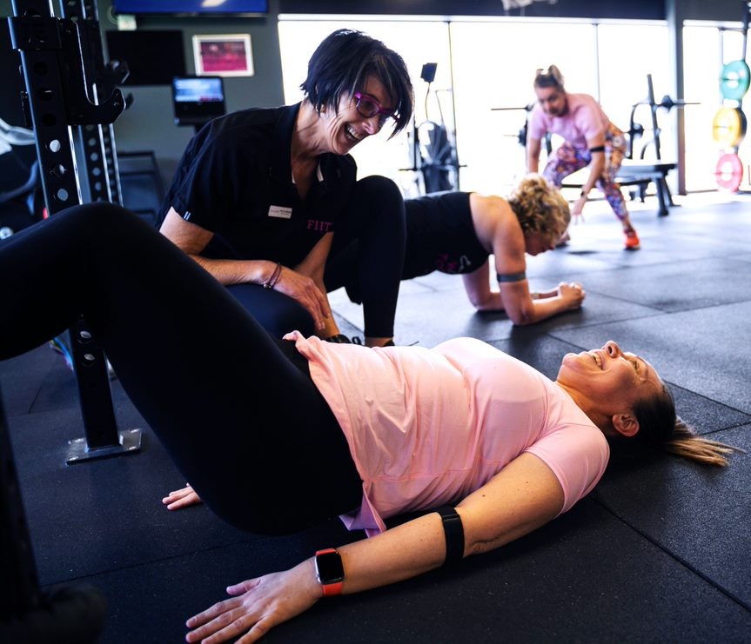
FIIT30 Session Styles
FIITRIGHT
TARGET GROUP: Beginners
FOCUS: Move, Core
WARM-UP: Big compound movements
MAIN WORKOUT: Slower speed of movement
TIMING: 1:1, 2:1
COOLDOWN: Core focus
FIIT30
TARGET GROUP: ALL members
FOCUS: Train & Play
WARM-UP: Constant movement into specific skill MAIN WORKOUT: Simple exercises with regression options TIMING: Minimum 2:1, EMOMs, AMRAPs
COOLDOWN: Mobility / Pulse lowerer
FIITMAX
TARGET GROUP: ALL members
FOCUS: Strength, Train, specialist class, semi personalised, “hit new heights”
WARM-UP: Specific to session/exercise MAIN WORKOUT: The skill into finisher or challenge TIMING: Longer work time – REP based, multiple sets per station for overload
COOLDOWN: Advanced mobility
Notes:
Now let’s start to break these formats down and focus on what they are really all about.
I often get asked, well what is the difference between FIIT30 and FIITRIGHT or FIIT30 and FIITMAX.
Is it the simple fact that FIITRIGHT has easier exercises and FIITMAX has harder exercises? And the answer to that is no, not necessarily. It all comes down to the programming and delivery.
FIITRIGHT really targets our beginners, but it’s also great for those who are recovering from injury or simply want to move at a slower pace.
The focus for FIITRIGHT is simply to get moving and also generally a core focus – we know that a solid strong core is the foundation of all successful movement so this is really important particularly in FIITRIGHT.
Warm-up in FIITRIGHT consists of big compound movements and the main workout focuses on slower speed of movement. Timing would be 1:1 or 1:2 for example so that could be working for 1 minute and resting for 1 minute or working for 30 seconds and resting for 1 minute. So we are still delivering all the same moves that we would in FIIT30 but just at a slower pace because we know our beginners will likely need longer time to master a movement and work on it, and a longer period of time to recover.
Cooldown for FIITRIGHT also has a core focus.
FIIT30 is for all of our members – everyone is welcome and everyone is capable. Trainers need be equipped with regressions for the newbies, and progressions for those advanced users.
The focus is train and play – work hard and have fun at the same time, That is really what FIIT30 is all about.
Warm-up consists of constant movement focusing on the specific skills that will be delivered in the session.
The main workout uses simple exercises – movements don’t have to be super fancy, keep them simple, practical and manageable.
Timing is a minimum of 2:1 so for example 45 seconds work and 15 seconds rest. But feedback has also been that the basic circuit, 8 stations, 45 on 15 off is getting tiresome. And let’s face it, that format on repeat week after week is boring. So in FIIT30 we also start to explore different formats like EMOMs and AMRAPs.
Cooldown should focus on mobility and stretches to lower the heart rate.
Lastly FIITMAX. The golden child and currently my favorite type of formatting!
FIITMAX is not for the elite. You don’t need to pass a special exam to receive VIP access. FIITMAX, just like FIIT30 is for everyone.
Focuses are strength and training hard. It’s a semi personalized strength session where members can focus on hitting new heights.
The warm up in FIITMAX is very much specific to what is being delivered in the session and the main workout focuses on specific skills with a finisher or a challenge to finish.
When I talk about skills I mean big lifts. This is a space where your participants can start working on their squats, deadlifts, bench presses, pull-ups etc.
So that means FIITMAX REP based as opposed to time based like FIITRIGHT and FIIT30. So for example you might give your class 6 minute blocks to perform 4 sets of deadlifts or squats etc.
Cooldown for FIITMAX focuses on advanced mobility.
So hopefully this gives you an understanding of how to differentiate between these session styles.

Slide 5
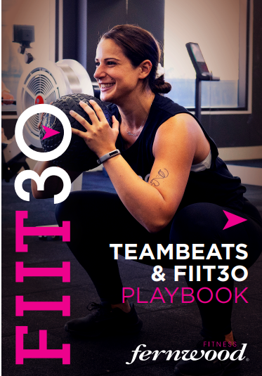
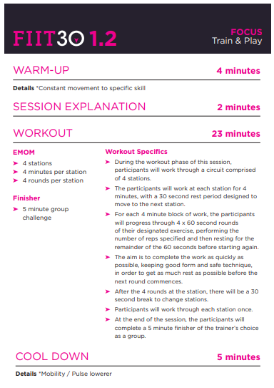
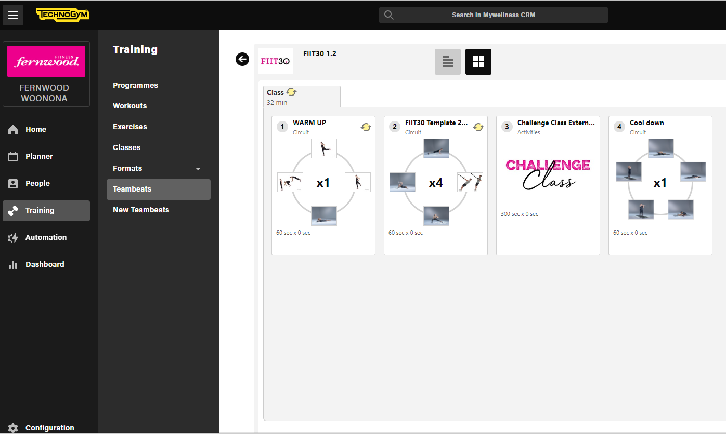
Teambeats & FIIT30 Programs and Playbook
Notes:
Now let’s take a look at formatting these sessions using Teambeats. A lot of the feedback around Teambeats, has been around programming being time consuming and challenging for trainers. That is why I have done the hard work for you and created the templates for you. All you need to do is find the program through the kiosk and hit play!
There are currently 9 templates loaded in your library, ready to use – 3 x FIITRIGHT, 3 x FIIT30 and 3 x FIITMAX. The templates come with accompanying education on the formats – called the teambeats playbook which basically explains step by step how the session is run. So you can see on the screen there FIIT30 1.2 has a thorough explanation of the class in the playbook, and then you can see it built out for you on the right hand side in Teambeats. And you can clone the templates and change the exercises as you please so if you want to make it all upper body, or all lower body or whatever, you can.
I really encourage you, if you haven’t already, to take a look at this playbook and start to play around and work with the templates that have been loaded there for you.

Slide 6
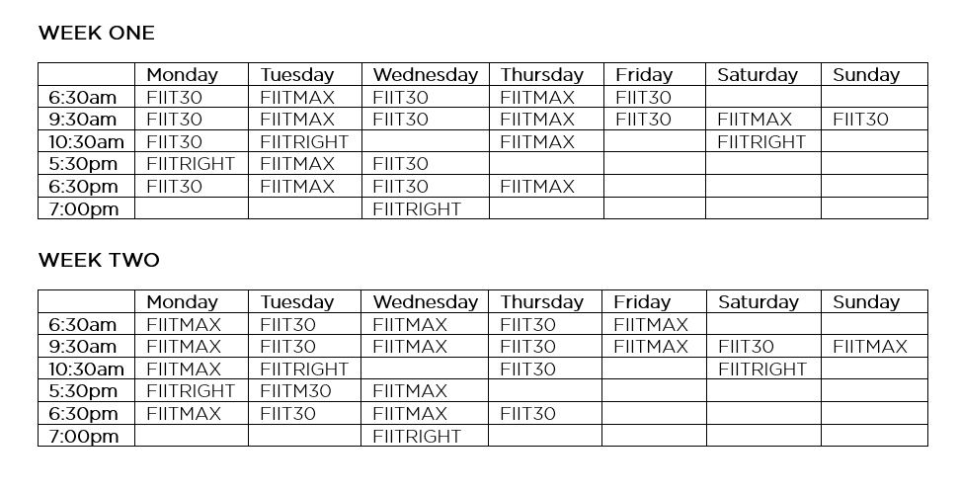
Your FIIT30 Timetable
Sessions should be run during peak times e.g. early mornings,
mid mornings, evenings and weekend mornings
- Consider running the same session across the entire day
Consider alternating FIIT30 & FIITMAX days
Schedule FIITRIGHT approximately 3 days per week, at
different times
- Your number of scheduled sessions will be dependent on coverage
Member Count – 1000
FIIT30 Coverage – 10% = 100 members
Average member = 2-3 sessions per week
100 members x 2.5 sessions = 250 sessions
250 sessions / 10 members per session
= 25 sessions per week
Member Count – 1000
FIIT30 Coverage – 5% = 50 members
Average member = 2-3 sessions per week
50 members x 2.5 sessions = 125 sessions
125 sessions / 10 members per session
= 12/13 sessions per week
Notes:
Now let’s take a look at your FIIT30 Timetable. What should it look like and what works best? Now of course this will be different for each club depending on the demographics and the kind of programs you are building in FIIT30.
Today I am just making some suggestions based on what I have seen work well in the clubs I have been working with.
The number of sessions you have on your Timetable is very much dependent on your coverage, but it’s important to ensure you have sessions scheduled in those peak times like early morning, mid morning, evening and weekend mornings.
My example on the screen here shows the timeslots to fill when starting out with your timetable. If you’re still getting your FIIT30 program off the ground, you don’t necessarily need to schedule sessions every day of the week in every timeslot, you might look at alternating the days. For example you may not put a 6:30am session on Monday to Friday to begin with, you might schedule it only for Mondays Wednesdays and Fridays or Tuesdays and Thursdays. Once you really start to build your membership base for FIIT30, you can then start to fill in those gaps.
When you are looking at building a timetable that includes all 3 of the formats we are talking about today, what I have seen work best is running the same session across the entire day. You might even consider alternating your FIIT30 and FIITRIGHT days which I have done in my example here. So at the top you can see FIIT30 runs on Mondays Wednesdays Fridays and Sundays, and FIITMAX runs Tuesdays, Thursdays and Saturdays.
This keeps it consistent for your members so they know exactly what to expect when they come in on any given day.
Now another consideration that has worked well with some of our clubs, is running a fortnightly timetable. So you can see here I have a week one and a week two option.
Week two is basically week one in reverse so whilst FIIT30 runs on Mondays Wednesdays and Fridays in week one, it will run on Tuesday, Thursday and Saturday in week 2.
So for example if you have a member that can only train on Mondays, Wednesdays and weekends, she will still be able to experience both FIITMAX and FIIT30 formats within a fortnightly cycle. Our Cranbourne, narre warren and clayton clubs do this really well and Nicolle can talk more on that later on.
Now lastly as I mentioned, your number of scheduled sessions will depend on your coverage. I have included a simple calculation on this slide, that you can use to determine a good starting point for how many sessions to schedule per week. This is based off 10 participants per session. You can adjust the calculation to suit your club based on your current member count, FIIT30 coverage and the number of participants your space will allow.

Slide 7
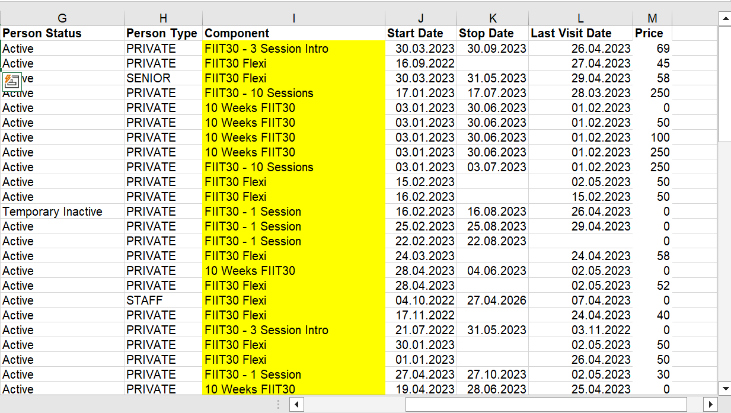
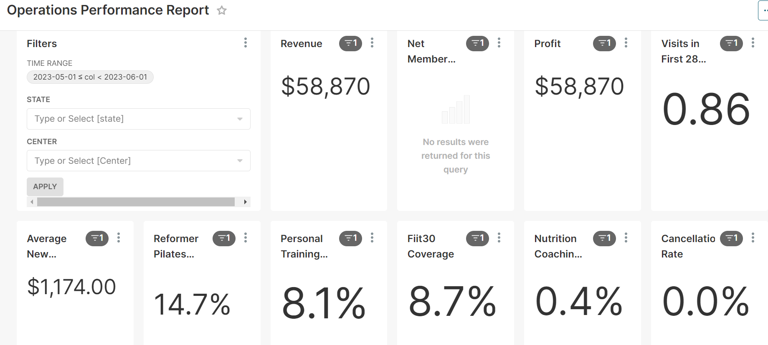
Understanding your FIIT30 numbers
Notes:
And on that coverage that I just spoken about - Having an understanding of who in your club is involved in your FIIT30 program and at what capacity is really important, and it’s really easy to obtain a snapshot of all these members with some of the programs we have access to.
To begin as you can see on the left hand side of the screen, you can take a look at the Operations Performance Report in Superset which will tell you what your coverage is for FIIT30, or across all of your core offerings for that matter.
This percentage includes 5 packs of FIIT30 or greater, flexi add-ons and subscriptions. It does not include single sessions, intro packs or anything with a zero dollar value.
Now as you can see on the right hands side of the screen, you can also take the core offerings report in Exerp to really hone in on some more information about those members. Really take note of your findings in the core offerings report. Whilst packs are often a good introduction to the program for our members, ultimately we them all paying for FIIT30 on direct debit. We love these members particularly, because they have fully committed to the program and are much easier to keep on board because essentially unless they downgrade, their weekly sessions never expire. So we don’t have to convince them to purchase another pack, once their last one has ended.
So take a look at your core offerings report and pay attention to your FIIT30 family – who are they and how can you maximise their stay within the program?

Slide 8
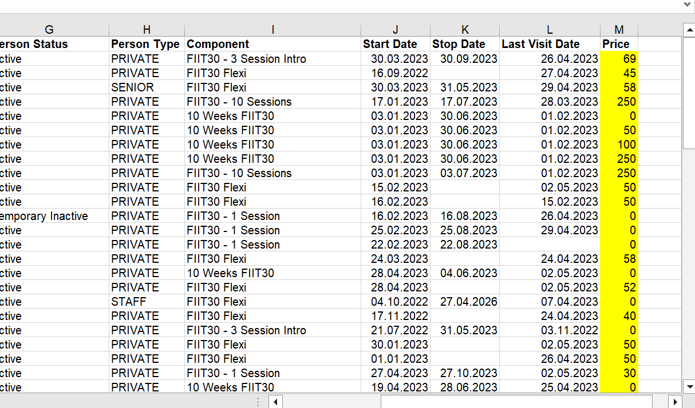

Your FIIT30 Pricing
- The recommended price for FIIT30 as a flexi add-on is $25 per week.
- A key goal in 2023 is to ensure all clubs implement a price point that is reflective of the high-quality
FIIT30 offering.
- If your members are paying less than $25 per week for this service, now is the perfect time to review this.
Notes:
Now analysing your FIIT30 family really leads me in to pricing, and what these ladies are paying for this product.
We know that one of the many benefits of FIIT30 is that it provides an additional stream of revenue to your club. And another big focal point for FIIT30 this year is pricing.
Our recommended price for FIIT30 as a flexi add-on is $25 per week, and whilst many clubs are charging $25, some even more, there are also many charging significantly less. A key goal is to ensure pricing is consistent across our network, to maintain a consistent and high level offering in every one of our clubs.
I have popped the little screenshot of the core offerings report back on this slide because as you can see on the right hand side, this report also tells you what your members have paid for the component. The figure next to the flexis is a fortnightly amount so as you can see with this case, some members are paying $25 per week for FIIT30, some $29 and so forth.
Now remember that in order to be able to charge $25 plus per week for this program, it needs to have the value to warrant the expense. When I talk about value I am talking about the professionalism of your programs – a fabulous timetable, enticing class variations, the use of the screens, heart rate training and professional, well trained and educated staff. All the things we continue to talk about when it comes to FIIT30. Tick all those boxes and you can without a doubt charge more for the service.
Clubs are comfortable and confident in charging a premium price for their reformer program, and we really should be treating FIIT30 the same.
Many clubs have submitted memberhips price increases to their members with minimal pushback, and certainly replicating this process for FIIT30 will be beneficial to your club so if you have not considered a price review for FIIT30, now is the perfect time!

Slide 9
Setting FIIT30 Targets
Do you set FIIT30 targets in your club?
What do FIIT30 targets look like?
How many members do you want to see in FIIT30?
What do you want them paying for the service?
What does your programming look like?
What does your space look like?
What does your team look like?
Consider GROWTH as your target, NOT upgrades
Project your up-coming downgrades (if any) to help set your monthly target
Our Network coverage for FIIT30 currently sits at 8.7%
Di’s vision is to see the network coverage at 15% by the end of 2023!
Who is in responsible in your club for hitting targets?
Notes:
Now let’s take a look at setting FIIT30 targets. Have a think about this before I move on? Do you have targets set for you as a trainer? As a manager, do you set targets for your team?
It is really important that you implement a FIIT30 growth plan. Planning will give you your best chance at success. Set targets around how may members you want to see in FIIT30. What do you want them paying for the service? What does your programming look like? What does your FIIT30 space look like? What does your team, look like?
Let’s focus on coverage targets today. I have been working with clubs recently on the growth of their FIIT30 program, and a key focus for targets has not been on upgrades, but on growth. Growth considers both upgrades, and downgrades together.
You could be upgrading 10 members to month to FIIT30, but also losing 10 members each month at the same time. So your program is really at a stand still. It’s not growing.
When you set your monthly growth targets, just like we do with sales, we can take a projection of the downgrades to come and use this number to set your growth target.
At the beginning of each month, take a downgrades report for the month ahead and see if there are any members scheduled to drop off FIIT30 for that month. This can be taken into consideration when planning your targets moving forward.
Now how do you set your targets? What should you be aiming for? This will vary from club to club and takes into consideration many factors like your member count and number of trainers on hand. If you would like some help with this, I am more than happy to discuss one-on-one outside of today’s training so please reach out.
Some key considerations for you to think about however;
Our Network average for FIIT30 is currently sitting at 8.7%. If you are below this number, then this might be a great target for you to strive for!
Di’s vision is to achieve 15% coverage for FIIT30 by the end of this year. Now we have a long way to go to achieve this number but I believe we can do this if we band together. The best way is to start setting those targets for growth.
Lastly, think about who is responsible for hitting these targets? Is it just up to the FIIT30 team leader, or do each individual trainer have their own target for upgrades each month. Teamwork makes the dreamwork so get everyone on board helping to build the numbers and that will ensure your biggest success.

Slide 10
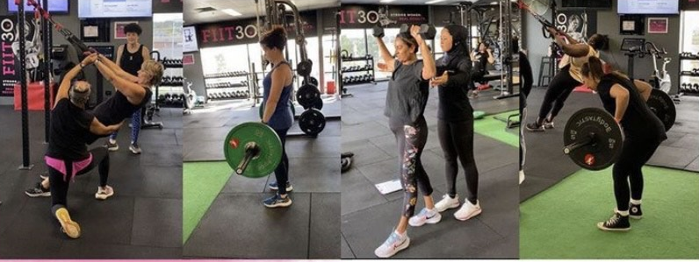
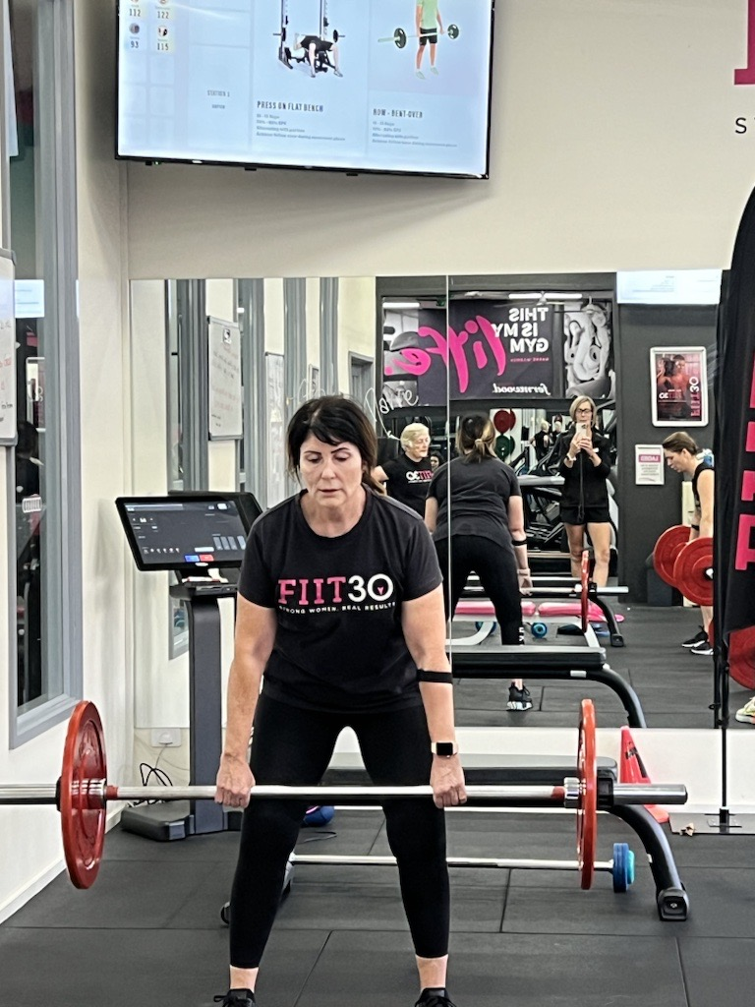
FIITMAX
Women want to build strength and focus on big lifts. This doesn’t have to be a form of training we only offer in PT.
In FIITMAX you will see exercises like squats, lunges, deadlifts, bench presses, pull ups etc.
It is an opportunity for trainers to deliver programs in 6 or 12 week blocks for example, so members can track their progression.
Notes:
Now let’s talk about FIITMAX. The current golden child of FIIT30 and my favourite format.
FIITMAX has become one of the more explored formats over the last few months. We well and truly know that women love to LIFT! Whilst circuit-style training is still popular and will always have a place in FIIT30, more and more women are wanting to build strength and focus on big lifts. This doesn't have to be a training style that features only in PT.
FIITMAX should focus on heavy strength training and building muscle. In FIITMAX you will see exercises like squats, lunges, deadlifts, bench presses, pull ups etc.
It is an opportunity for trainers to delivery programs in 6 or 12 week blocks for example, so members can track their progression.
If you are looking for a way to shake up your program, and invite new members into your FIIT30 space, then consider FIITMAX if you haven’t already. It is definitely the direction we need to be heading when it comes to small group functional training at Fernwood.
Soon we will hear from our 3 FIIT30 superstars who will talk about FIITMAX in their club, what it looks like, and what the benefits are.

Slide 11
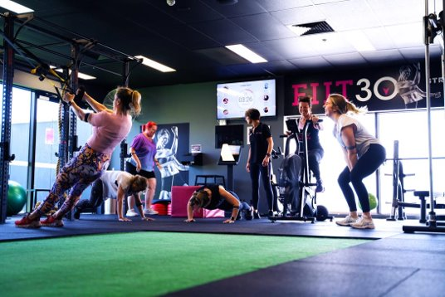
FIIT30 Training & Development Program
- Working with clubs to improve your FIIT30 performance
- FIIT30 Programming, Teambeats, Heart Rate Training
- Lead Generation, Retention
- Sales, Upgrades, Price Presenting, Setting Club & Staff Targets
- St Kilda built their coverage from launch to 5% within 6 weeks with over 95% of those members on a DD
Notes:
Last year I began working with clubs on a 6 week FIIT30 Training and Development Program, and will continue to do so over the coming months. This program is designed to build the success of the program in your club and focuses on topics such as digital programming, class scheduling, upgrades, setting targets, lead gen and retention.
As an example I worked with the lovely team at St Kilda last year and supported them through their FIIT30 launch. Within 6 weeks their coverage was at 5% with over 95% of those members paying $25 per week for the service. A fantastic and very achievable result in such a short time.
So if this is something that is of interest to you, please feel free to get in touch after today’s webinar so I can schedule you in to the next round.

Slide 12
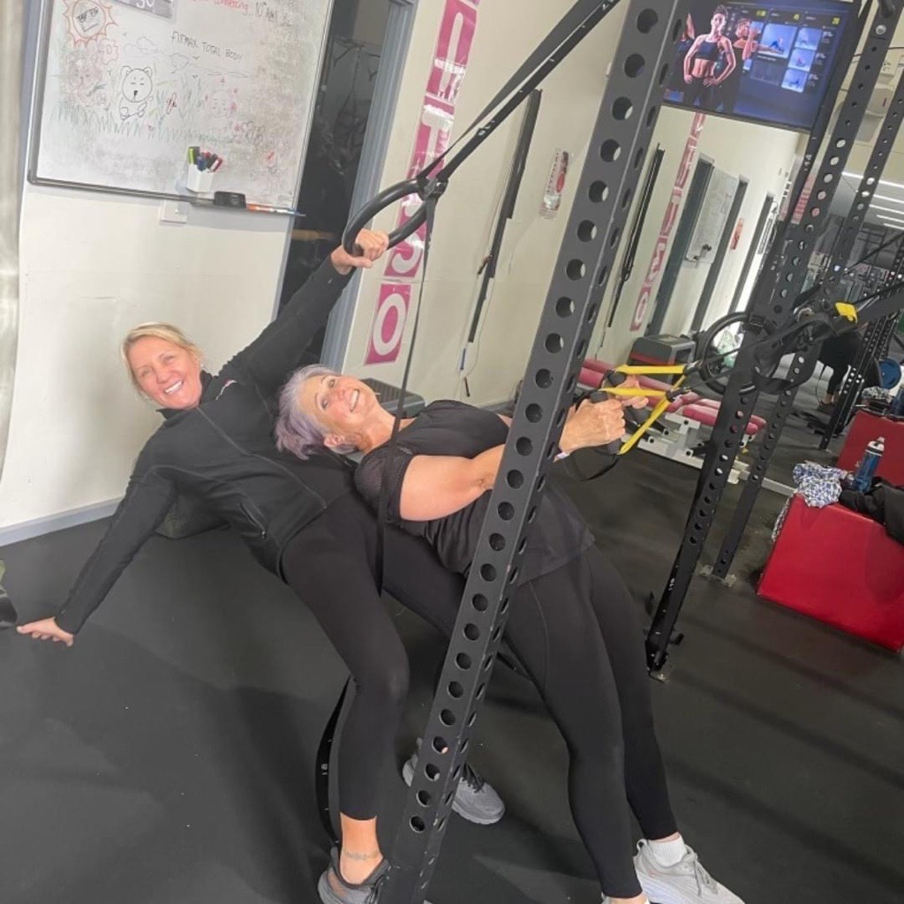
Trainer Upskilling
As part of our FIIT30 National Training for 2023, we are working on the upskilling of our trainers to ensure diverse programming, and safe and efficient coaching to ensure high level quality of FIIT30 sessions across the Network.
Up-coming events
QLD – Sunday 21st May, Fernwood North Lakes
NSW – Sunday 18th June, Fernwood Beverley Hills
ACT – Sunday 25th June, Fernwood Tuggeranong
Notes:
As I mentioned earlier, we need to keep evolving as quickly as our industry is evolving. Upskilling yourself as a trainer is the best way to evolve and keep up with industry trends and best practice. As a trainer ask yourself, do you have the skillset to be delivering functional training elements safely and effectively to your members? If you are programming Kettlebell and Suspension exercises in your programs, have you trained in those areas yourself to ensure efficiency in your delivery?
We have noticed a gap in these areas and so that is why as part of our National FIIT30 training this year, alongside today’s webinar, we have a fantastic master trainer Roger Sehali, who is an expert in the fields of kettlebell and suspension training, delivering specialized training in these areas. I encourage you all to get on board for these events which I have listed on the right here.
QLD, NSW and ACT are to come so please take note and get yourself registered.
I’ve just put a cheeky photo up here of Tracey and Andrea from our Ballarat club who recently attended the vic training. Looks like they had lots of fun. We received some great feedback from the event.
The course is extremely affordable and accredited for 14 CECs through AUSactive which is a fantastic return for one day training

Slide 13
Let’s hear from…
Kate, Browns Plains
Notes:
Ok now let’s move into the fun part of the day – and that’s hearing from some of the ladies that are running successful FIIT30 programs in their clubs.
Let’s start with Kate from Brown’s Plains.
So Kate, you have always run a successful FIIT30 program at Browns Plains and you’re currently implementing a plan to shake it up a bit. Can you talk to us about what made you want to make those changes and what some of those plans are that you are putting in place?
We have also been talking a lot about Timetabling and you have done some great work building the perfect Timetable for your members. I am particularly interested in your FIITRIGHT induction program and I know everyone online today would love to hear about it too. Can you tell us more please?

Slide 14
Let’s hear from…
Nicolle, Narre Warren
Notes:
Now we have the lovely Nicolle from Narre Warren.
Nicolle you have been doing some brilliant things across all three of your sites, mainly around the launch of FIITMAX. Can you talk to us about the launch, how the planning went, and perhaps some of the challenges that came along with that launch?
Push back from members
Trainers

Slide 15
Let’s hear from…
Talyse & Kristy, Woonona
Notes:
Lastly let’s chat to the lovely Talyse and Kristy from Woonona
Talyse I would like to start with you. You and the team are absolutely fantastic at getting members on board your FIIT30 program. In fact you are currently sitting at a whopping 17.2% coverage for FIIT30 which is one of the highest in our Network. Can you talk to us about how you achieve this and what the best way is to build the program at Woonona
Kristy can you talk to us about your programming, mainly FIITMAX and why your members love this style of training so much?

